Slide 1

React JS
JavaScript Library
By Ramesh Mesam
Check my repo for example app
https://github.com/rameshmeesam/react-form-wizard

Slide 2
Following topics will cover in this session
React JS Introduction
Features
Rendering Elements
React JS Life Cycle
Handling Events
States
Props
About Pure Component
Higher Order Component(HOC)

Slide 3
What is React JS
ReactJS is an open-source JavaScript library which is used for building user interfaces specifically for single page applications.
It’s used for handling view layer for web and mobile apps. React also allows us to create reusable UI components.
React is a component-based framework. In React terms, a component is usually defined as a function of its state and props.

Slide 4

Features
Component-Based
Virtual DOM
One-way data binding
JSX
Simplicity
Performance

Slide 5
How to create React App
Install NodeJS (https://nodejs.org/en/)
Node >= 8.10, npm >= 5.6
npx create-react-app my-app
cd my-app
npm start
Recommended Toolchains
If you’re learning React or creating a new single-page app, use Create React App.
If you’re building a server-rendered website with Node.js, try Next.js.
If you’re building a static content-oriented website, try Gatsby.

Slide 6
How to add React to website
Add a DOM Container to the HTML
<div id=“msg"></div>
Add the Script Tags
<script src="https://unpkg.com/react@16/umd/react.development.js" crossorigin></script>
<script src="https://unpkg.com/react-dom@16/umd/react-dom.development.js" crossorigin></script>
<!-- Load our React component. -->
<script src=“msg.js"></script>

Slide 7
React App Directory Structure
my-app ├── build ├── node_modules ├── public │ ├── favicon.ico │ ├── index.html │ └── manifest.json ├── src │ ├── App.css │ ├── App.js │ ├── App.test.js │ ├── index.css │ ├── index.js │ ├── logo.svg │ └── serviceWorker.js ├── .gitignore ├── package.json └── README.md

Slide 8
Components let you split the UI into independent, reusable pieces.
Components are like JavaScript functions. They accept arbitrary inputs (called “props”) and return React elements describing what should appear on the screen.
Example
class Welcome extends React.Component {
render() {
return <h1>Hello, {this.props.name}</h1>;
}
}
<Welcome name=“John” />
About React Component

Slide 9
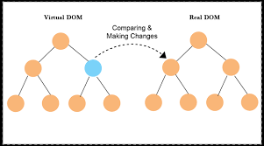
What is the Virtual DOM
The virtual DOM (VDOM) is a programming concept where an ideal, or “virtual”, representation of a UI is kept in memory and synced with the “real” DOM by a library such as ReactDOM
Without Virtual Dom
With Virtual Dom
Using New State
Update Dom
Compared DOM’s current state to Desired new state
Update the DOM in the most efficient way

Slide 10
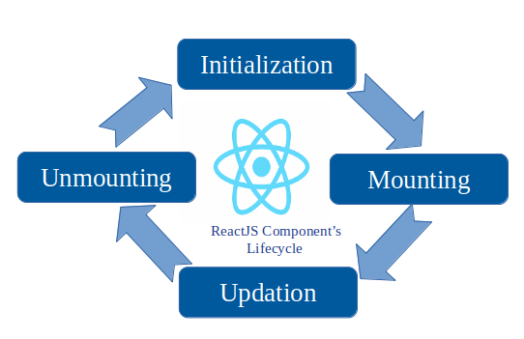
Mounting
constructor
static getDerivedStateFromProps
render
componentDidMount
Updating
static getDerivedStateFromProps
shouldComponentUpdate
render()
getSnapshotBeforeUpdate
componentDidUpdate
Unmounting
componentWillUnmount
Component Life Cycle

Slide 11
Class
Functional
Component Types

Slide 12
Class Component
A class component requires you to extend from React.Component and create a render function which returns a React element.
Example
class Welcome extends React.Component { render() { return <h1>Hello, {this.props.name}</h1>; } }

Slide 13
Function Component
A functional component is just a plain JavaScript function which accepts props as an argument and returns a React element.
Example
function Welcome(props) { return <h1>Hello, {props.name}</h1>; }

Slide 14
Class VS Function Component
Class Components are more complex than functional components
These components are statefull
Can support react life-cycle methods.
Easier to understand
Avoid ‘this’ key word
Less transpiled code
Easy to test

Slide 15
Elements are the smallest building blocks of React apps
React elements are plain objects
React elements are immutable
The only way to update the UI is to create a new element, and pass it to ReactDOM.render()
React Only Updates What’s Necessary
React Elements

Slide 16
Rendering Elements
const element = <h1>Hello, world</h1>;
Rendering an Element into the DOM
<div id="root"></div>
ReactDOM.render(element, document.getElementById('root'));

Slide 17
Handling events with React elements is very similar to handling events on DOM elements
React events are named using camelCase, rather than lowercase.
With JSX you pass a function as the event handler, rather than a string
Handling Events

Slide 18
“state”, an object that determines how that component renders & behaves.
In other words, “state” is what allows you to create components that are dynamic and interactive.
State can be mutable only using setState()
Should not be accessed from child components. Need to pass it down with props instead
State

Slide 19
A React component can be considered pure if it renders the same output for the same state and props.
React.PureComponent implements it with a shallow prop and state comparison
React provides the PureComponent for class component
Class components that extend the React.PureComponent class are treated as pure components.
Have some performance improvements and render optimizations since React implements the shouldComponentUpdate()
Pure Component

Slide 20
A higher-order component is a function that takes a component and returns a new component
A higher-order component transforms a component into another component.
HOCs are common in third-party React libraries, such as Redux’s connect
Example
const EnhancedComponent = higherOrderComponent(WrappedComponent)
Higher Order Component(HOC)

Slide 21
Login Component
import React from 'react';
class Login extends React.Component {
constructor(props){
super(props);
this.state = {
username: '',
userPassword: '',
error: null,
isLoaded: false,
webToken: null
}
}
onChangeHandler = (e) => {
this.setState({ [e.target.name]: e.target.value });
}

Slide 22
handleSubmit = (e) => {
e.preventDefault();
let data = {
"email": this.state.username,
"password": this.state.userPassword
}
let req = {
method: 'POST',
headers: new Headers({
'Content-Type': 'application/json'
}),
body: JSON.stringify(data)
}

Slide 23
fetch('http://localhost:3000/api/login', req )
.then(res => res.json())
.then((result) => {
this.setState({
isLoaded: true,
webToken: result
})
console.log("got token : " + result.token );
},
(error) => {
this.setState({
isLoaded: true,
error: error
});
console.log(" got error : " + error);
//console.log("got error : " + error);
}
);
}

Slide 24
render(){
return(
<div className="wizard-box">
<>
<form onSubmit={this.handleSubmit}>
<div className="form-box">
<h2 className="texhit-center">Login</h2>
<div className="form-group">
<input type="email" value={this.state.username} className="form-control" name="username" id="username" placeholder="username" onChange={this.onChangeHandler} required="required" />
</div>
<div className="form-group">
<input type="password" value={this.state.userPassword} className="form-control" name="userPassword" id="userPassword" placeholder="password" onChange={this.onChangeHandler} required="required" />
</div>

Slide 25
<div className="form-group">
<button type="submit" >Submit</button>
</div>
</div>
</form>
</>
</div>
);
}
}
export default Login

Slide 26
Thank you

